Slide 1
Decision Trees
Entropy: Entropy is a metric to measure the impurity in a given attribute. It specifies randomness in data. Entropy can be calculated as:
Entropy(s)= -P(yes)log2 P(yes)- P(no) log2 P(no)
Where,
S= Total number of samples
P(yes)= Probability of yes
P(no)= Probability of no
Information Gain:
It calculates how much information a feature provides us about a class.
According to the value of information gain, we split the node and build the decision tree.
A decision tree algorithm always tries to maximize the value of information gain, and a node/attribute having the highest information gain is split first. It can be calculated using the below formula
Information Gain= Entropy(S)- [(Weighted Avg) *Entropy(each feature)

Slide 2
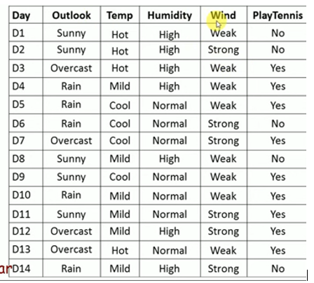

Slide 3


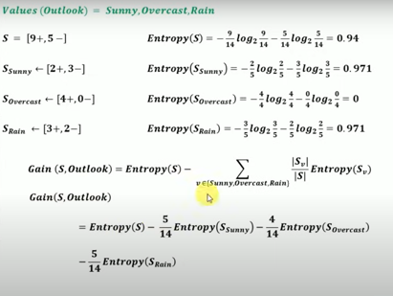
Entropy of Total Dataset:

Slide 4

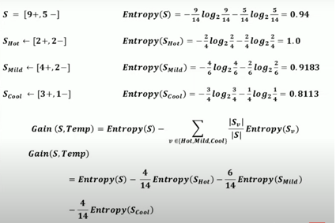

Slide 5

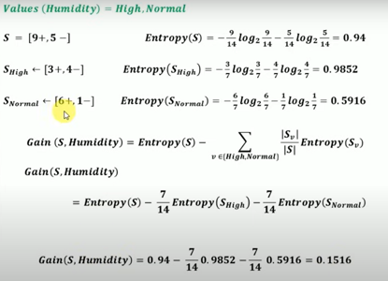

Slide 6

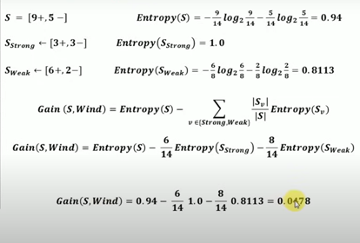

Slide 7
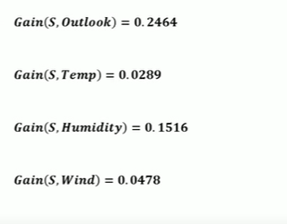
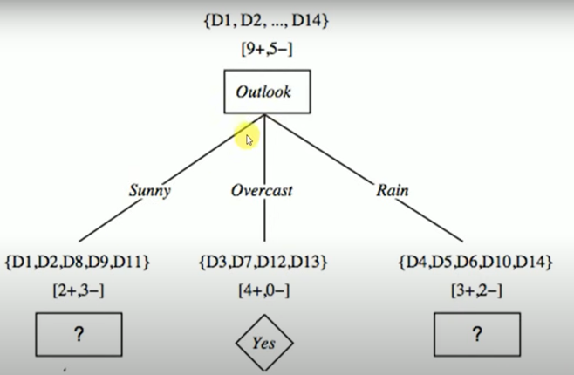
Information Gain All the Attributes
Among all the attribute in the Dataset Outlook got More Information Gain so we have to consider Outlook has Root Node and we need to draw Leaf nodes i.e. Sunny,Overcast,Rainy
Aa

Slide 8
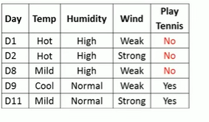
We need to 14 examples from Left and side for Root Node

Slide 9



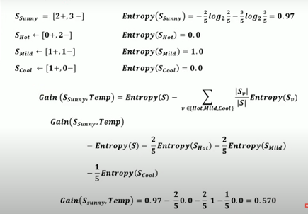
Entropy of Sunny(Left Side)

Slide 10
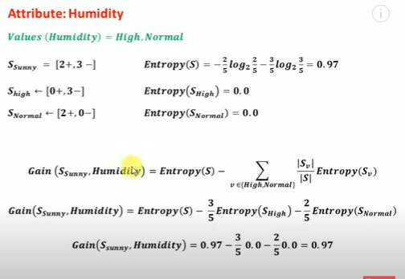

Slide 11
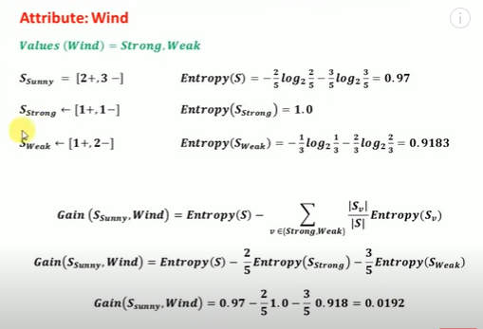

Slide 12
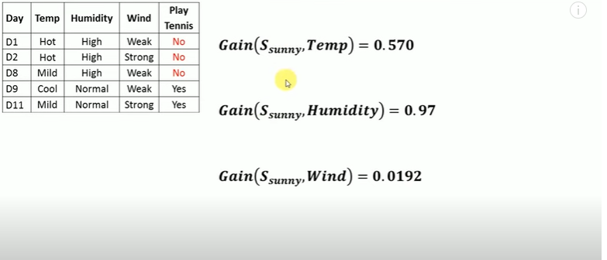
Information Gain
Here Humidity got high information gain we need consider Humidity for this level

Slide 13
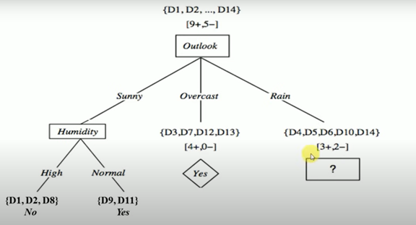
Decision Tree for Next Level

Slide 14

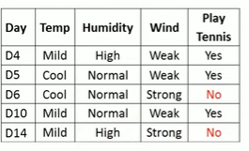

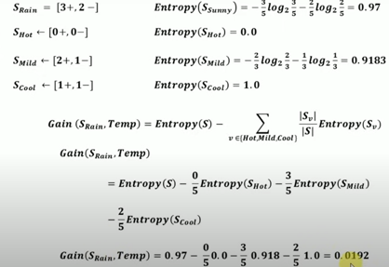
Entropy of Rain(Right Side)

Slide 15
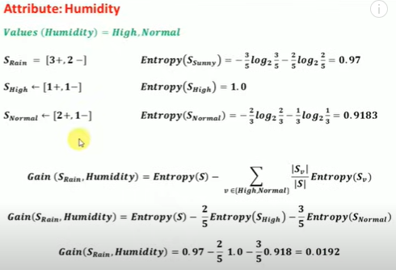

Slide 16
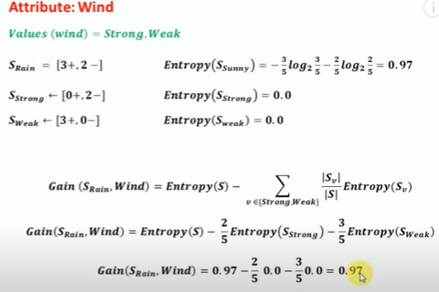

Slide 17
